Slide 1


Fernando Gutiérrez Nieto
December 29,2024

Slide 2

Outline
Executive Summary
Introduction
Methodology
Results
Conclusion
Appendix

Slide 3
Executive Summary
SpaceX has emerged as a leader in the aerospace industry, revolutionizing the economics of space exploration through innovative technologies. While traditional rocket launches cost approximately $165 million, SpaceX achieves comparable objectives at a significantly lower cost of $60 million, thanks to its reusable rocket systems.
This report evaluates the feasibility of competing with SpaceX by analyzing historical launch data. By leveraging SpaceX's REST API and supplementary web-scraped datasets, we performed data preprocessing, exploratory data analysis (EDA), and predictive modeling to uncover critical factors driving SpaceX's success.
To enhance our findings, interactive visual analytics were created using Folium and Plotly Dash, providing detailed insights into launch site performance, payload characteristics, and success trends. Furthermore, machine learning models, such as Decision Trees and Logistic Regression, were utilized to predict the success of first-stage landings.
The insights derived from this analysis offer actionable strategies for new market entrants, like Space Y, to optimize their operations and improve competitiveness in the space industry.

Slide 4
Introduction
Since the launch of Sputnik in 1957, the space race has driven nations and private entities to innovate in aerospace technologies. However, the high costs associated with space missions have historically posed significant barriers, with traditional rocket launches averaging $165 million per mission. SpaceX has revolutionized this landscape through groundbreaking advancements, such as reusable first-stage rockets, reducing costs to approximately $60 million. This innovative approach has not only made space exploration more attainable but also set a new standard for efficiency within the industry.
This project examines the critical factors contributing to successful first-stage rocket landings. By applying data science methodologies, we analyze variables such as payload mass, launch site, orbit type, and launch trends. The insights derived aim to inform strategies for competing in the rapidly expanding private aerospace sector.

Slide 5

Section 1

Slide 6
Methodology
Executive Summary
Data Collection Methodology: Data was collected using the SpaceX REST API and enriched with additional information obtained through web scraping techniques from relevant Wikipedia pages.
Data Wrangling: The dataset was preprocessed using Pandas and NumPy. Key steps included one-hot encoding, removal of irrelevant columns, and normalization/standardization of data to ensure consistency and readiness for analysis.
Exploratory Data Analysis (EDA): Comprehensive visualization and statistical analysis were performed using libraries such as Seaborn and Matplotlib. Additionally, SQL queries were utilized to conduct more granular investigations of the dataset.
Interactive Visual Analytics: Dynamic and interactive visualizations were developed using Folium and Plotly Dash. These tools facilitated deeper insights and provided an intuitive platform for exploring the data interactively.
Predictive Analysis with Classification Models: The dataset was split into training and testing subsets. Classification models were optimized using Grid Search to identify the best-performing algorithms and hyperparameters. The final model was deployed to generate effective predictions.

Slide 7
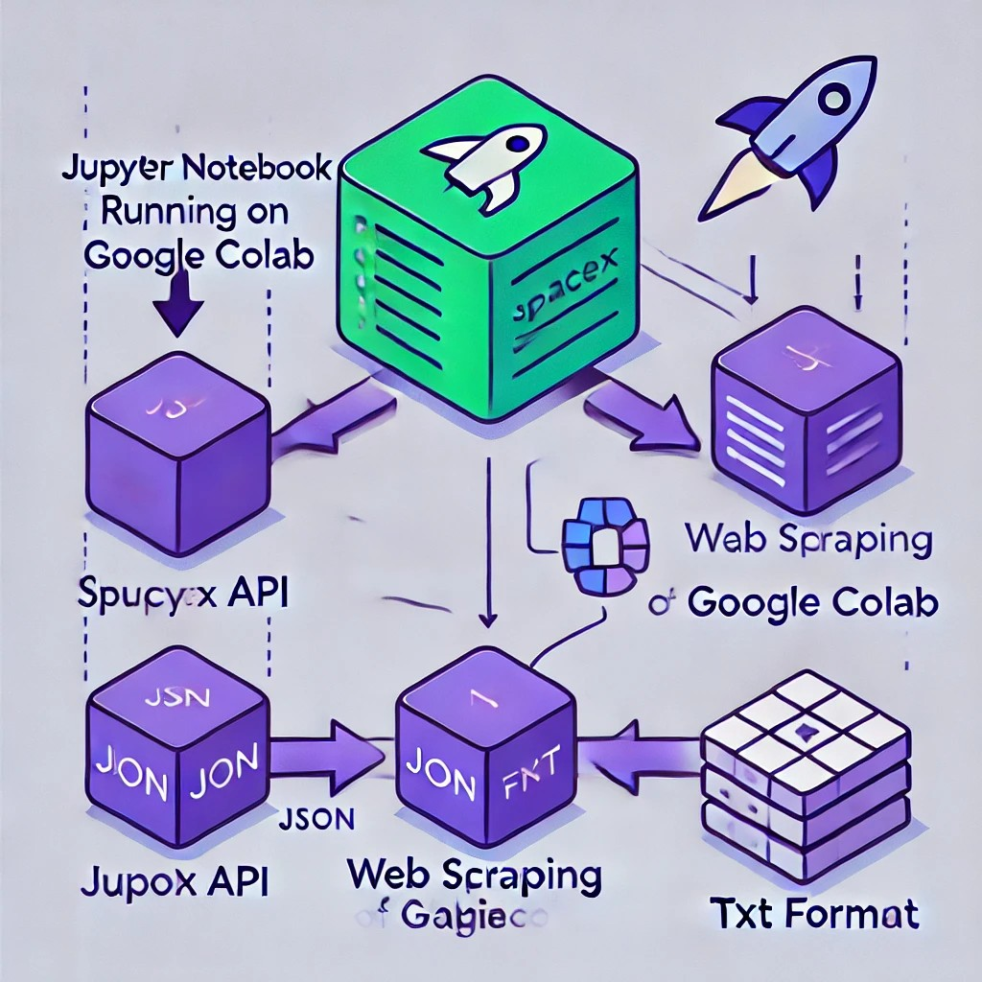
Data Collection
SpaceX API: A publicly accessible REST API offering detailed information on launches, rockets, cores, capsules, Starlink satellites, launchpads, and landing pads.
Wikipedia: A free, collaborative online encyclopedia maintained by volunteers and hosted by the Wikimedia Foundation, serving as a valuable source of comprehensive information.

Slide 8
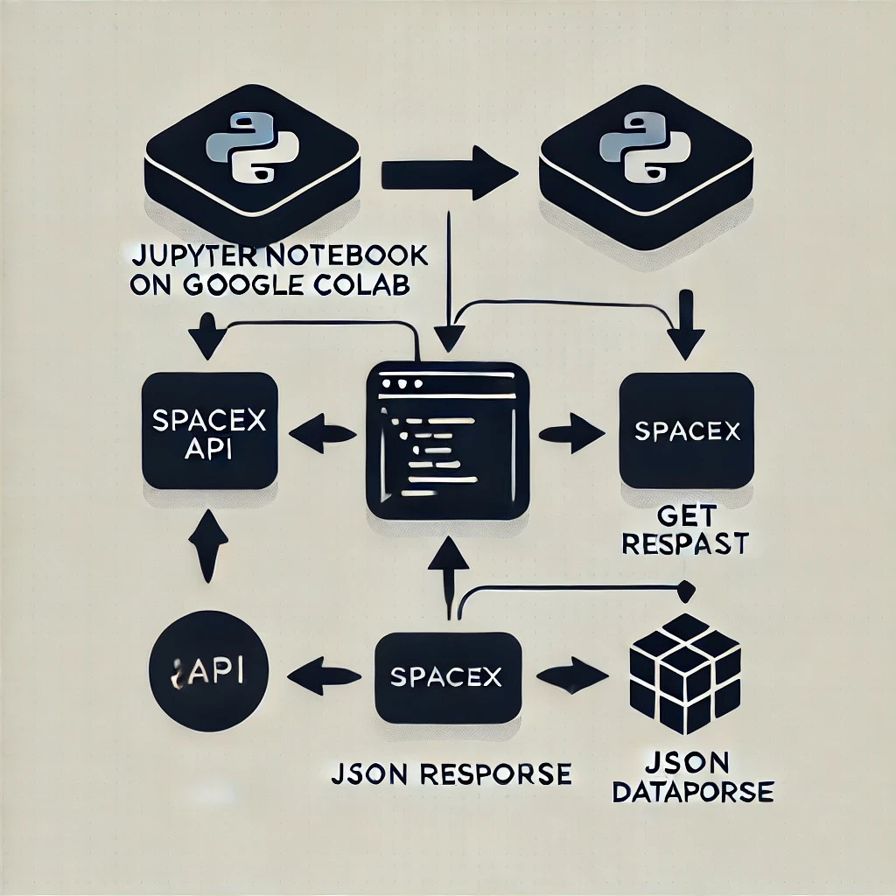
Data Collection – SpaceX API
Process Overview
Initiation: Used Jupyter Notebook on IBM Watson to import key libraries like Pandas, NumPy, and Requests.
API Request: Sent a GET request to the SpaceX API and extracted relevant data such as geospatial details, rocket types, orbit information, and flight numbers.
Data Conversion: Converted the JSON response into a Pandas DataFrame for analysis and visualization.
Additional Resources Explore the complete SpaceX API implementation on GitHub:

Slide 9
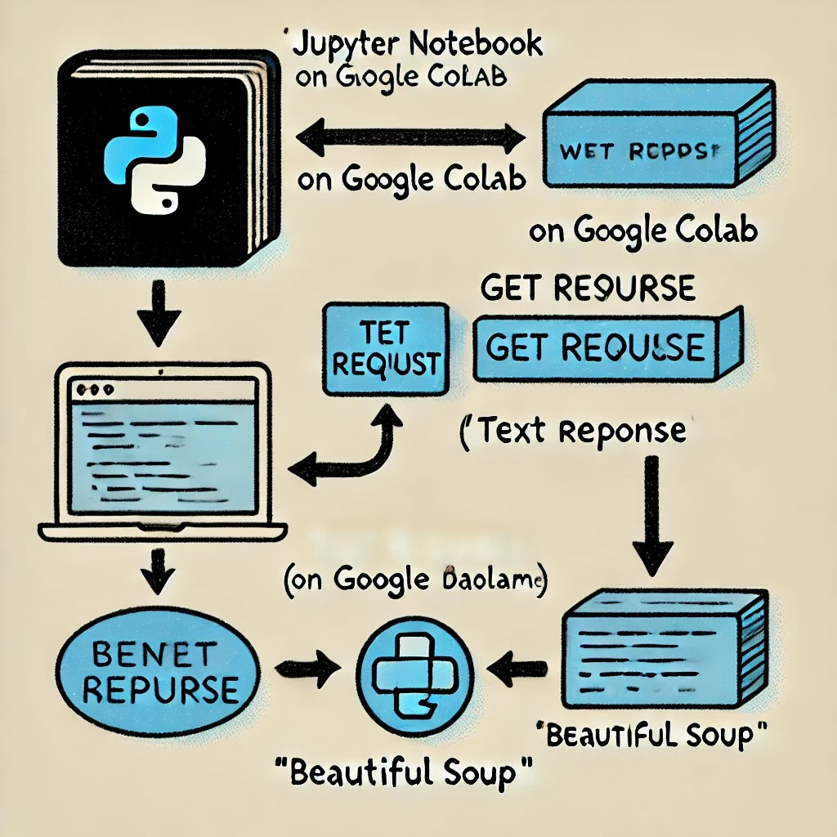
Data Collection - Scraping
Process Overview
To complete this task, we used Python libraries like BeautifulSoup and Requests to scrape data from the Wikipedia page “SpaceX Falcon 9 First Stage Landing Prediction.”
An HTTP GET request retrieved the webpage content in text format.
Using BeautifulSoup, we extracted the relevant tables and columns.
The extracted data was structured and stored in a Pandas DataFrame for analysis.
The full web scraping notebook is available in the GitHub repository.

Slide 10

Data Wrangling
Loading the collected dataset
Identifying and calculating the percentage of missing values in each attribute
Identifying which columns are numerical and categorical
Calculating the number of launches on each site
Calculating the number and occurrence of each orbit
Creating a landing outcome label from the Outcome column
Determining the success rate of returning the first stage of the rocket
Github repository: The completed Data Wrangling notebook can be accessed here Lin

Slide 11
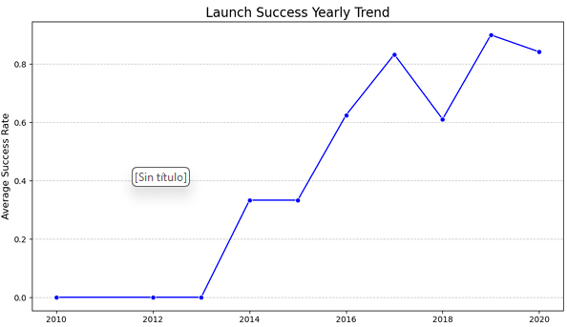
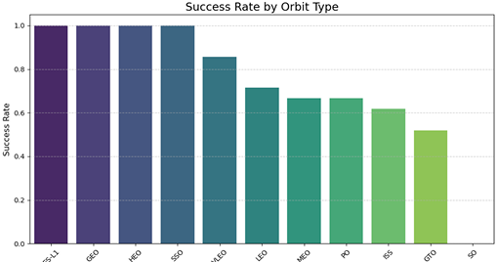
EDA with Data Visualization
We analyzed the data by visualizing the relationships between flight number and launch site, payload and launch site, the success rate of each orbit type, flight number and orbit type, as well as the yearly trend in launch success

Slide 12
EDA with SQL
Display the unique launch site names from the space mission.
Show 5 records where the launch site names start with "CCA".
Calculate the total payload mass carried by boosters launched by NASA (CRS).Identify the date of the first successful ground pad landing.
List the booster names that succeeded on drone ships and carried payloads between 4000 and 6000.Count the total number of successful and failed mission outcomes.
Find the booster versions that carried the maximum payload mass using a subquery.
List failed drone ship landings, including booster versions and launch site names, for the year 2015.Rank the count of landing outcomes (e.g., "Failure (drone ship)" or "Success (ground pad)") between June 4, 2010, and March 20, 2017, in descending order.
GitHub Repository: The completed EDA with SQL notebook is available [here].

Slide 13
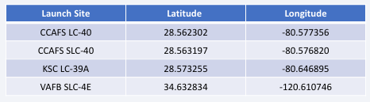
Build an Interactive Map with Folium
Process OverviewWe utilized the Folium library to represent our analysis as geospatial data. This was achieved by adding markers, such as circles and lines, to an interactive map.
Launch Site MarkersWe began by placing circular markers on the map to highlight the four Falcon 9 rocket launch sites. The coordinates for these sites are as follows:
Success/Failure Markers Markers were placed at these locations to indicate whether the rocket's first stage successfully returned or failed.
Distance Calculation We computed the distances from CCAFS LC-40 to three important points:
The nearest city.
The coastline.
A nearby highway.
Using this data, we added polylines to the map to visually display these distances.
GitHub Repository The completed interactive map, along with the Folium notebook, can be accessed [here].

Slide 14
Build a Dashboard with Plotly Dash
Process Overview
We used the Plotly library to create an interactive dashboard for our analysis. Here are the main tasks performed:
Added a dropdown menu to select a launch site, with options such as "All Sites," "CCAFS LC-40," "CCAFS SLC-40," "VAFB SLC-4E," and "KSC LC-39A."Included a pie chart to display the total count of successful launches for all sites.
Added a slider to filter payload values within the range of 0 to 10,000.
Created a scatter chart to illustrate the correlation between payload and launch success.
GitHub Repository: The completed notebook with interactive dashboard routines is available [here].

Slide 15
Predictive Analysis (Classification)
Machine Learning Stages
Import Libraries: Start by importing the necessary libraries for data manipulation and model development.
Load Pre-Processed Data: Use the cleaned dataset to ensure it is ready for analysis.
Standardize Data: Normalize the dataset to reduce bias during model training.
Split the Dataset: Separate the data into training (80%) and testing (20%) sets to evaluate model performance.
Initialize Models: Configure four classification algorithms for comparison: Logistic Regression (LR), Support Vector Machine (SVM), Decision Tree (DT), and K-Nearest Neighbors (KNN).
Optimize Hyperparameters: Use Grid Search to test various parameter combinations and identify the best-performing model.
Evaluate Performance: Measure model performance using metrics such as the Confusion Matrix, F1 Score, and Jaccard Score.
Additional Resources Explore the full implementation of the Predictive Analysis Lab on GitHub [here].

Slide 16
Results
Exploratory data analysis results
Interactive analytics demo in screenshots
Predictive analysis results

Slide 17

Section 2

Slide 18
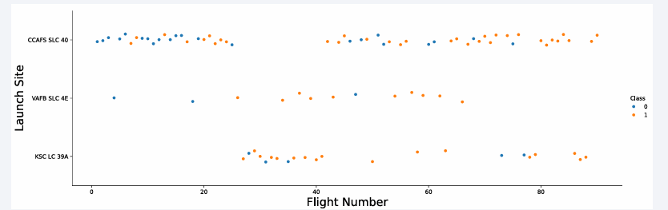
Flight Number vs. Launch Site
Comments
CAFS SLC-40: The most frequently used SpaceX launch site, with 55 trials—33 successes and 22 failures, resulting in a 60% success rate.
VAFB SLC-4E: The least used site, with 13 trials—10 successes and 3 failures, achieving a 77% success rate.
KSC LC-39A: A moderately used site, with 22 trials—17 successes and 5 failures, also achieving a 77% success rate.

Slide 19
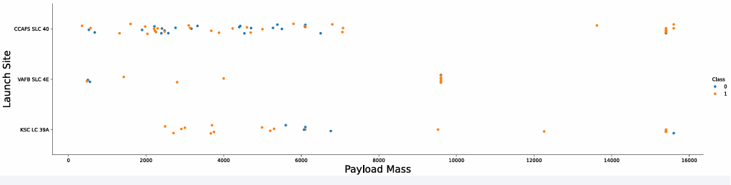
Payload vs. Launch Site
Comments
Based on the plot above, there appears to be no strong correlation between payload mass and the success of the first-stage return, as the number of successful and failed trials is approximately equal.

Slide 20
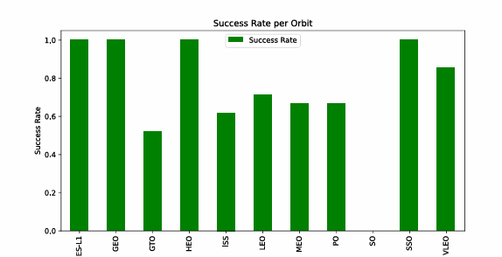
Success Rate vs. Orbit Type
Comments
The bar plot shows that the most successful orbits for first-stage returns are ES L1, GEO, HEO, and SSO. In contrast, GTO is the worst-performing orbit. Understanding the factors contributing to GTO's poor performance is crucial for reducing failures in first-stage returns.

Slide 21
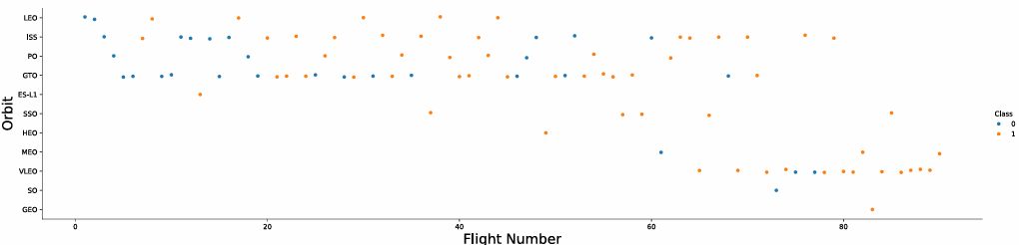
Flight Number vs. Orbit Type
Comments
In the LEO orbit, success seems to be linked to the number of flights. However, in the GTO orbit, no clear relationship is observed between the number of flights and success.

Slide 22
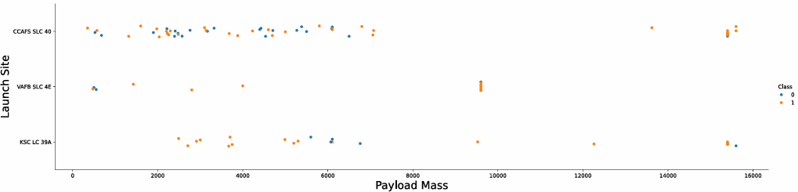
Payload vs. Orbit Type
Comments
Heavy payloads negatively affect GTO orbits but have a positive impact on Polar, LEO, and ISS orbits, where the success rate for landings is higher with heavier payloads. However, in GTO orbits, distinguishing between successful and unsuccessful landings is challenging, as both outcomes are observed.

Slide 23
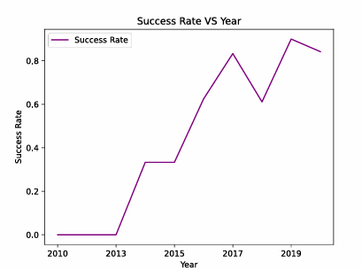
Launch Success Yearly Trend
Comments
The success rate shows a steady increase from 2013 to 2020.

Slide 24
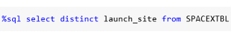
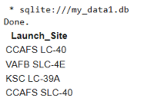
All Launch Site Names
We use the following query to retrieve the names of the unique launch sites.
There are 4 sites for rockets launches

Slide 25
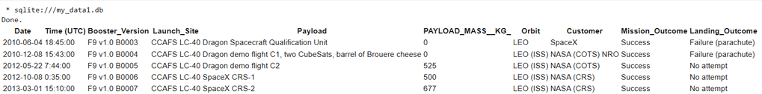
Launch Site Names Begin with 'CCA'
We used the following query to retrieve 5 records where the launch site names start with
Output:

Slide 26
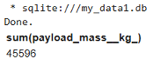
Total Payload Mass
We used the following query to calculate the total payload carried by NASA boosters.
Following output:
NASA has transported a total payload of 45,596 kg to outer space using SpaceX rockets, equivalent to approximately 50.261 US tons.

Slide 27
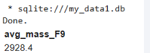
Average Payload Mass by F9 v1.1
We used the following query to calculate the average payload mass carried by the F9 v1.1 booster version.
Following output:
The Falcon 9 booster version v1.1 has an average payload mass of 2,928.4 kg.

Slide 28
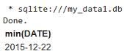
First Successful Ground Landing Date
We used the following query to determine the dates of the first successful landing on a ground pad.
Following output:
The Falcon 9 achieved its first successful ground pad landing on December 22, 2015, during flight 20. This milestone at Cape Canaveral marked a breakthrough in SpaceX's reusable rocket technology.

Slide 29
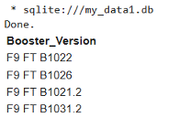
Successful Drone Ship Landing with Payload between 4000 and 6000
We used the following query to list boosters that successfully landed on a drone ship with payloads between 4000 and 6000 kg.
Following output:
This indicates that only four boosters successfully landed on a drone ship with payloads between 4000 and 6000 kg.

Slide 30
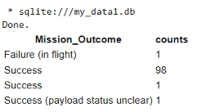
Total Number of Successful and Failure Mission Outcomes
We used the following query to determine the total number of successful and failed mission outcomes.
Following output:

Slide 31
Boosters Carried Maximum Payload
List the names of the booster which have carried the maximum payload mass
Present your query result with a short explanation here

Slide 32
2015 Launch Records
List the failed landing_outcomes in drone ship, their booster versions, and launch site names for in year 2015
Present your query result with a short explanation here

Slide 33
Rank Landing Outcomes Between 2010-06-04 and 2017-03-20
Rank the count of landing outcomes (such as Failure (drone ship) or Success (ground pad)) between the date 2010-06-04 and 2017-03-20, in descending order
Present your query result with a short explanation here

Slide 34

Section 3

Slide 35
<Folium Map Screenshot 1>
Replace <Folium map screenshot 1> title with an appropriate title
Explore the generated folium map and make a proper screenshot to include all launch sites’ location markers on a global map
Explain the important elements and findings on the screenshot

Slide 36
<Folium Map Screenshot 2>
Replace <Folium map screenshot 2> title with an appropriate title
Explore the folium map and make a proper screenshot to show the color-labeled launch outcomes on the map
Explain the important elements and findings on the screenshot

Slide 37
<Folium Map Screenshot 3>
Replace <Folium map screenshot 3> title with an appropriate title
Explore the generated folium map and show the screenshot of a selected launch site to its proximities such as railway, highway, coastline, with distance calculated and displayed
Explain the important elements and findings on the screenshot

Slide 38

Section 4

Slide 39
<Dashboard Screenshot 1>
Replace <Dashboard screenshot 1> title with an appropriate title
Show the screenshot of launch success count for all sites, in a piechart
Explain the important elements and findings on the screenshot

Slide 40
<Dashboard Screenshot 2>
Replace <Dashboard screenshot 2> title with an appropriate title
Show the screenshot of the piechart for the launch site with highest launch success ratio
Explain the important elements and findings on the screenshot

Slide 41
<Dashboard Screenshot 3>
Replace <Dashboard screenshot 3> title with an appropriate title
Show screenshots of Payload vs. Launch Outcome scatter plot for all sites, with different payload selected in the range slider
Explain the important elements and findings on the screenshot, such as which payload range or booster version have the largest success rate, etc.

Slide 42

Section 5

Slide 43
Classification Accuracy
Visualize the built model accuracy for all built classification models, in a bar chart
Find which model has the highest classification accuracy

Slide 44
Confusion Matrix
Show the confusion matrix of the best performing model with an explanation

Slide 45
Conclusions
Point 1
Point 2
Point 3
Point 4
…

Slide 46
Appendix
Include any relevant assets like Python code snippets, SQL queries, charts, Notebook outputs, or data sets that you may have created during this project

Slide 47


